Slide 1

Qt Introduction
C++ Framework for a Cross-Platform Development

Slide 2
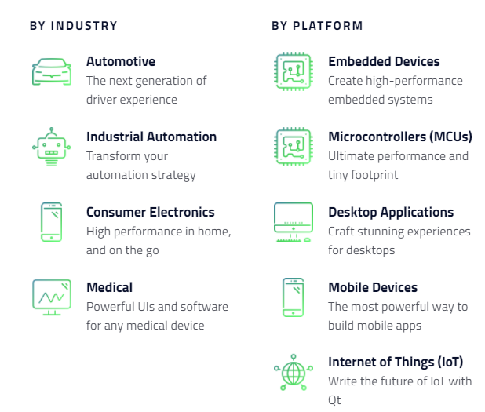
What is Qt?
It’s called Qt (cutie) for a reason
Basically, Qt is a Development Framework that was created for improving/facilitating the UI development with C++ for multiple platforms.
Qt API provides additional features for easier cross-platform development and is a light-weight Framework usefull for Development of Embedded and Mobile Applications.
The Qt API is written in C++, but there are several bindings to Qt for other languages as Python (officially maintained), Go, Rust, PHP and Java.

Slide 3
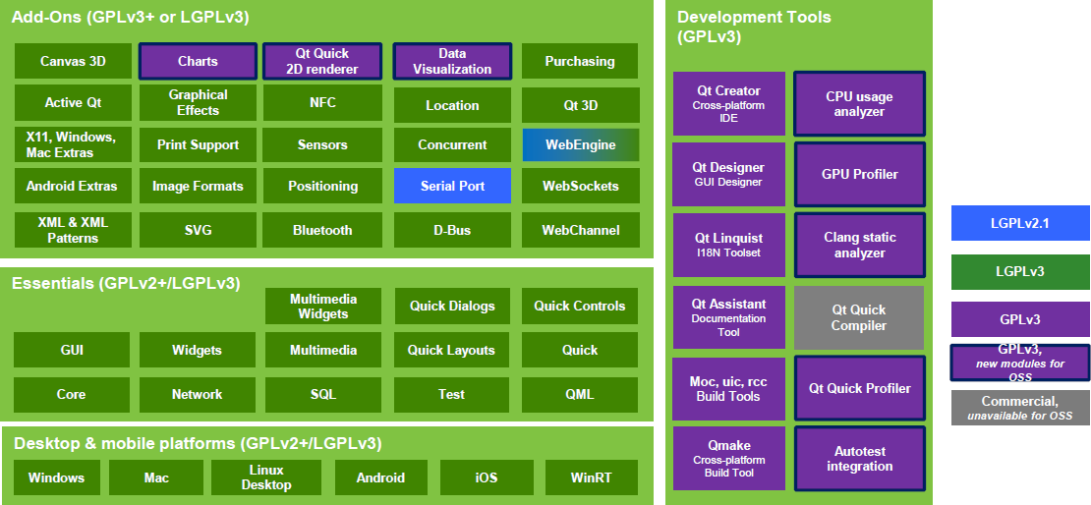
Qt Modules
Notes:
Qt Core: The only required Qt module, containing classes used by other modules, including the meta-object system, concurrency and threading, containers, event system, plugins and I/O facilities.

Slide 4
Qt Core Module
Core Functionalities
Qt Core adds these features to C++:
a very powerful mechanism for seamless object communication called signals and slots
queryable and designable object properties
hierarchical and queryable object trees that organize
object ownership in a natural way with guarded pointers
a dynamic cast that works across library boundaries

Slide 5
How much of C++ do you need to know?
Objects and Classes
Declaring a class, inheritance, calling member functions, etc.
Polymorphism
Virtual Methods
Operator Overloading
bool operator == (const Complex& c);
Templates
Limited to the container and concurrent classes

Slide 6
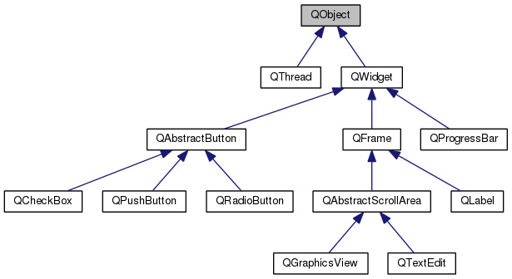
Qt’s C++ Object Model - QObject
QObject is the most basic class in Qt and provides some very powerful capabilities like:
object name: you can set a name, as a string, to an object and search for objects by names.
parenting sytem: next topics
Signals and Slots: next topics
Event Management
QObject has no image representation.
It’s used as a base class for most of the classes in Qt.

Slide 7
Parenting System
Any object that inherits from QObject can have a parent and children. This hierarchy tree makes many things convenient:
When an object is destroyed, all of its children are destroyed as well. So, calling delete becomes optional in certain cases.
All QObjects have findChild and findChildren methods that can be used to search for children of a given object.
Child widgets in a QWidget automatically appear inside the parent widget.

Slide 8
Observer Pattern
Observer pattern is used when an observable object wants to notify other observers objects about a state change. Here are some concrete examples:
A user has clicked on a button, and a menu should be displayed.
A web page just finished loading, and a process should extract some information from this loaded page.
An user is scrolling through a list of items (in an app store for example), and reached the end, so other items should be loaded.
Observer pattern is used everywhere in GUI applications, and often leads to some repetitive code, with many interfaces (IObservable and IObserver) for each object or attribute that needs to be observed.

Slide 9
Sample page with dark-blue background
The author fills the page with his individual texts
This is a placeholder for the first bullet point

Slide 10
Pattern diagram for copying and pasting
Level 0
Content for this level
Level 1
Content for this level
Level 2
Content for this level
Level 2
Content for this level
Level 2
Content for this level
Logical Group/Level 3
Content for this level
Level 5
Content for this level
Logical Group/Level 3
Content for this level
Level 5
Content for this level
Level 5
Content for this level
Level 4
Content for this level
Level 4
Content for this level
Level 4
Content for this level

Slide 11
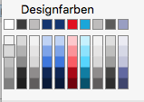
Pattern table for copying and pasting
Header = Calibri bold, 14 pt | Header | Header | Header
Content = Calibri light, 12 pt.

Slide 12
Pattern table for copying and pasting
Header = Calibri bold, 14 pt | Header | Header | Header
Bullet Point Bullet Point .... | Bullet Point Bullet Point .... | Bullet Point Bullet Point .... | Bullet Point Bullet Point ....
Bullet Point Bullet Point .... | Bullet Point Bullet Point .... | Bullet Point Bullet Point .... | Bullet Point Bullet Point ....

Slide 13
Page Layouts
To copy and paste

